Slide 1


Intelligence d’affaires
Titre du cours : Intelligence d'affaires: principes et méthodes

Slide 2
Intelligence d’affaires
L’analyse informationnelle (tableau de bord)
La veille stratégique, technologique et concurrentiel
La gestion de la connaissance
Automatisation des processus ( algorithme)
+ dernièrement le phénomème Big DATA
+ dernièrement l’Intelligence artificielle

Slide 3
Définition
Intelligence d’affaires - Business Intelligence (BI)
Un ensemble de concepts, de méthodologies et d’application pour rassembler, stocker, analyser et permettre d’accéder à des données dans le but d’aider les utilisateurs d’entreprises dans leur processus d’affaires.
Permet de transformer:
Les données en information
Les informations en connaissances
Les connaissances en stratégies menant à des actions profitables à l’entreprise.

Slide 4
Business Intelligence and Information Management initiative leaders are faced with the following challenge: Enterprises have invested billions of dollars to create and manage information, but workers and managers still can't get the right information at the right time to make good decisions and improve business performance. In other ways, the economic conditions brought a renaissance of thinking and activity regarding information — as enterprises realized that many of their cost and risk issues resulted from poor information management and business decision practices.
Breaking down business, information and technology silos to better exploit information assets to make better decisions and improve business performance requires a strategic approach.
Our 201X research will focus primarily on providing guidance to help clients devise and execute such strategies.–
Bill Hostman, VP Distinguished Analyst, Gartner Research

Slide 5

Michael Porter - Big Ideas
- Strategy is about making choices, trade-offs; it's about deliberatly
choosing to be different.
- A strategy delineates a territory in wich a company seeks to be unique.
Strategy 101 is about choices: You can't be all things to all people.
- The essence of strategy is that you must set limits on what you're
trying to accomplish.
Technology changes, strategy doesn't
- The underlying principles of strategy are enduring, regardless of technology or
the pace of change.
Strategy hasn't change, but change has
- On the other hand, I agree that the half-life of everything has shortened.
setting strategy has become a little more complicated. In the old days, maybe 20
years ago, you could set a direction for your
Great strategies are a cause
-The best CEOs I know are teachers and at the core of what teach is strategy. They
go out to employees, to suppliers, and to customers, and they repeat, “ This is what
we stand for, this is what we stand for .” So everyone understands it.
This is what leaders do.
March 2001

Slide 6
Recherche sur Gartner pour effectuer de IA
Exemple …
Gartner's CIO Survey Provides Keys of BI informations

Slide 7
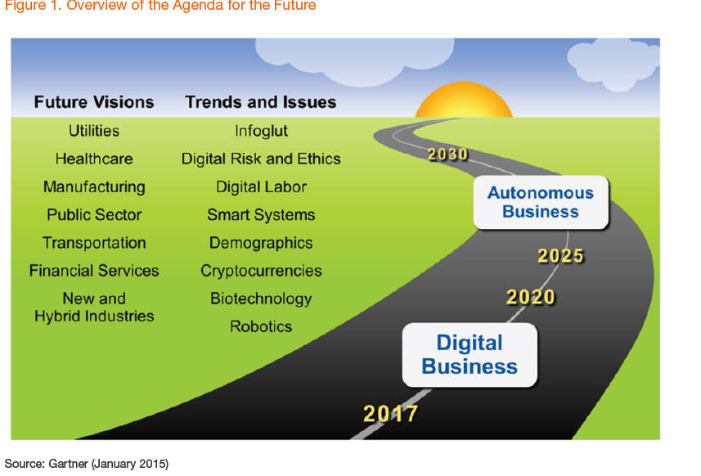
Agenda Overview for the Agenda for the Future, 2015..30

Slide 8
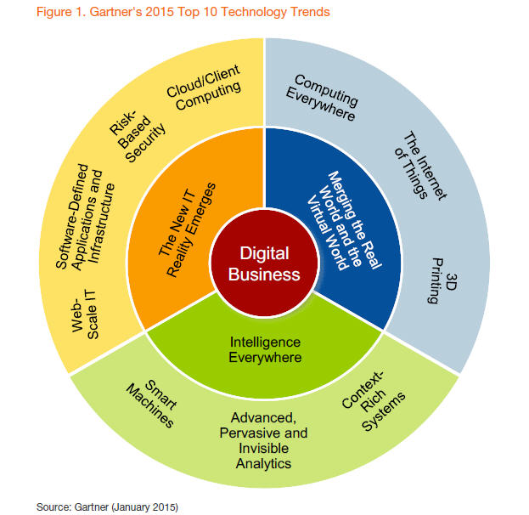
The Top 10 Strategic Technology Trends for 2015-1X
Le plus important c’est que ca aide à faire des choix

Slide 9
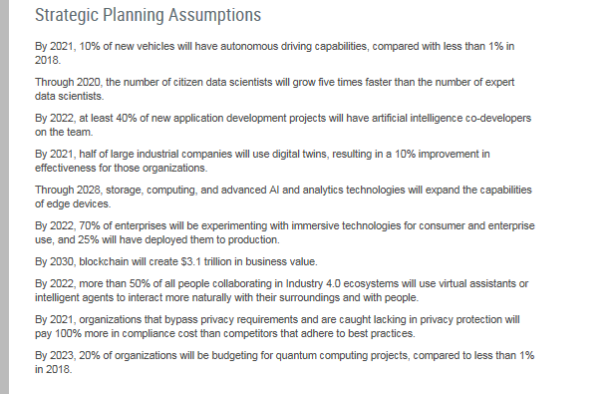
Strategic Planning Assumptions (Gartner 2019-20)

Slide 10
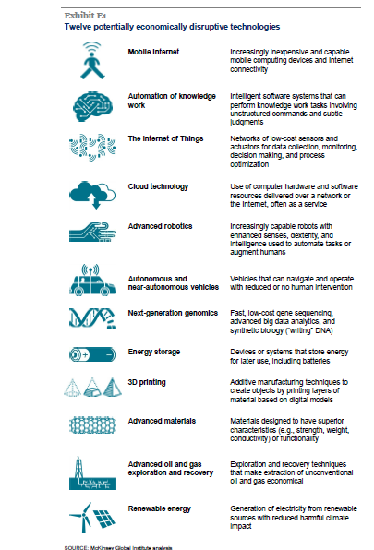

Perturber l’évolution Technologique

Slide 11
Nous venons de faire de IA en se documentant sur un sujet pour mieux prendre des décisions dans le futur…..

